Slide 1
Valuing Road-Transport Noise Abatement Measures
Duco de Vos

Slide 2
Road Noise
External effect of road transport
‘missing market’ for tranquillity
Social cost of €17 billion/year (CEDelft, 2011)
Annoyance and health-costs
Environmental Noise Directive (EU, 2002)
Reduce harmful noise exposure
No hard limit noise-values

Slide 3
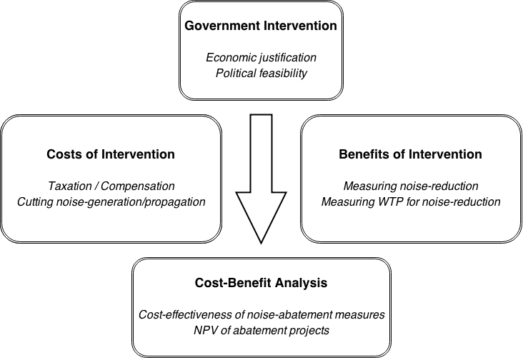

Slide 4
Political environment
Political support
Providing accurate information can raise support
Combining restrictive traffic-measures with promotion of other transport modes
Taxation / Compensation
Electronic Road Pricing lacks public support
Compensation schemes are especially relevant for airport noise

Slide 5
Noise abatement measures
Noise generation
Silent tires, silent tarmac, vehicle specifications, traffic volume/speed (Traffic Management)
Noise propagation
Noise barrier walls, housing insulation
Costs are largely ignored in academic research

Slide 6
Willingness-to-pay for noise reduction
Hedonic Pricing method
WTP is subdivided in terms of product characteristics (Rosen, 1974)
Assumptions (Bateman, 1993)
Aggregate WTP reflects social benefit
Environmental quality changes are perceivable (i.e. they affect housing prices)
Competitive housing market, free acces, perfect information
The housing market is always in equilbrium

Slide 7
Willingness-to-pay for noise reduction
Stated preference method
Simulated market for the externality
Questionnaire techniques
HP vs. SP
HP based on real choices, SP is hypothetical
SP takes into account non-user valuations

Slide 8
Earlier research
Many studies use ‘benefit transfer’
WTP values based on a few meta-analyses
Importance of Spatial confounders in HP
Spatial econometrics is widely used
Quasi-experimental set-up is rare
A study concerning aircraft noise (Pope, 2008) indicates the importance of the information environment using quasi-experiments

Slide 9
Novel research methods
“Using happiness surveys to value intangibles: The case of airport noise.” (Van Praag & Baarsma, 2005)
Happiness as a function of income, noise, etc.
Does not assume housing market equilibrium
Might deal with strategic response behavior
Methodological issues…

Slide 10
Research suggestions
HP analysis to obtain WTP values for road-noise reduction in the Netherlands
Cost-effectiveness of noise-barriers and housing insulation
Digging into the appropriateness of using happiness surveys in externality-valuation studies
Search for quasi-experiment application

